Slide 1




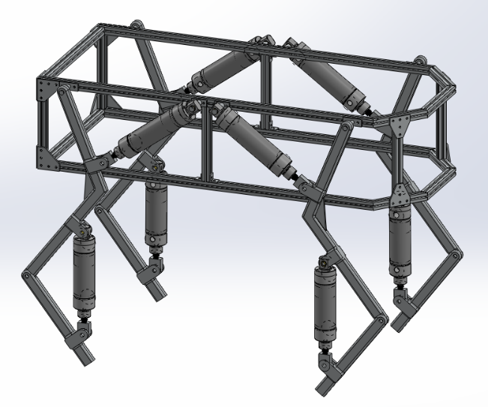
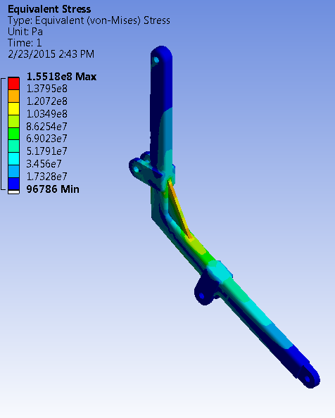
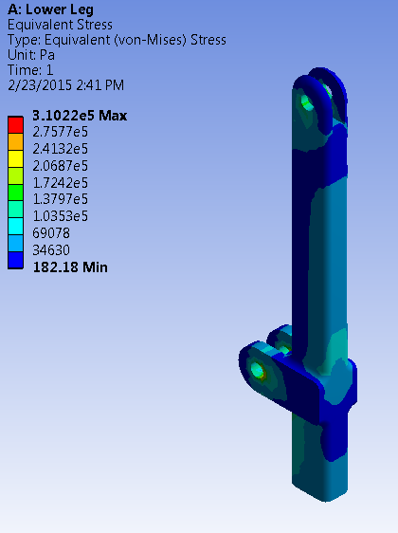
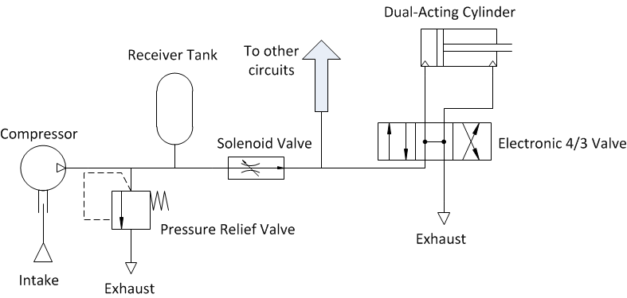
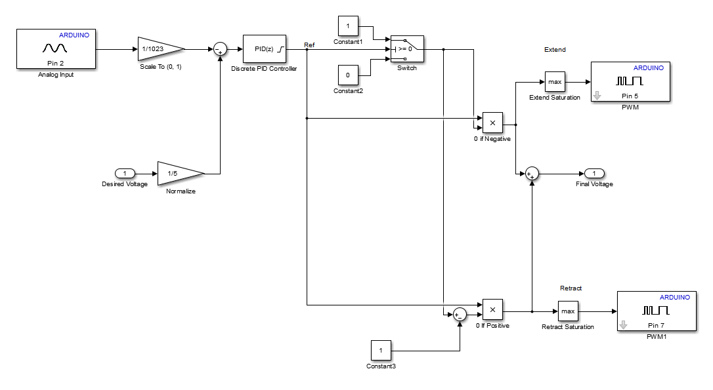
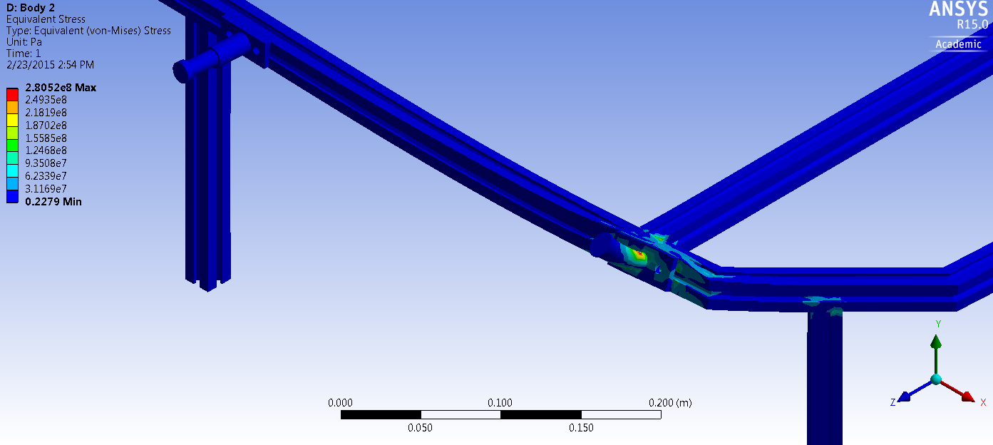
Development of an Agile Educational Robot
Team A.R.C.
Logan Beaver
Justin Campbell
Tyler Paddock
Ronald Shipman
Spring, 2015
Problem Statement
Milwaukee School of Engineering (MSOE) participates in community outreach programs where science, technology, engineering, and mathematics (STEM) topics are demonstrated to encourage younger generations to enter into STEM based degrees and careers. Having an automated control system to demonstrate and interact with would increase the excitement at these outreach programs. Development of a robot with pneumatic locomotion for the Milwaukee School of Engineering’s controls classes would give students a first-hand experience with complex control systems.
Design Constraints/Criteria
A maximum weight of 35 kg for portability
Maximum size of 0.75 m x 0.75 m x 1.0 m box for portability
Custom debug panel creation to facilitate troubleshooting
MATLAB and Simulink model support to allow mechanical engineering students to update control algorithms without knowledge of C/C++
Electronic fuses and shielding to protect the robot and operator during use and maintenance
Mechanical protection to reduce the risk of pinching and self-collision damage to the robot
An easy to access emergency stop to quickly depower the robot
A pressure relief valve to reduce the risk of overloading and damaging pneumatic components
Human Machine Interface
The user requests a direction of movement using a joy stick. The microcontroller onboard the robot receives the user’s request, but does not move until it is in a stable state and ready to accept another command.
Sequence of Events in Sending a Command
User input is read by a USB controller
Real time Java application parses user input
Application sends commands through an XBee radio module
Partner XBee chip receives the command and sends it to the Arduino microcontroller
Arduino decodes the serial command executes an action accordingly
Mechanical Design
Chassis Construction
6105-T5 T-Slotted Aluminum Framing (Yield Strength = 275 Mpa)
6061 Aluminum Plate (Yield Strength = 276 Mpa)
Leg Construction
6061 Aluminum Bar (Yield Strength = 276 Mpa)
Arduino Mega 2560
Pneumatic Design
Using pneumatic systems as the driving force for the legs, the following components will be utilized:
Double-acting, air cylinders with position feedback sensors (1.5 in. bore diameter)
Two-solenoid 4 way 3 position directional control valves (0.37 C_{v})
Air-compressor
Pressure relief valve
Soft start/dump solenoid valve
Secondary receiver tank
XBee
XBee
High Level Communication System Diagram
Control Architecture: Two Link Leg
Mathworks Simulink model is loaded onto the Arduino
Utilizes PID feedback loops to control cylinder lengths
Desired length is calculated by a state machine based on user input and current length
Control Subsystem For a Single Leg
Electrical Design
The electronics of the robot are separated into subsystems. The communication subsystem, microcontroller subsystem, motherboard subsystem, and debug panel subsystem. The communication subsystem interfaces a user controlled computer with the Arduino microcontroller using Xbee modules. The microcontroller subsystem includes the microcontroller, Xbee shield, and battery supply for the microcontroller. This microcontroller battery supply is implemented as a standard replaceable 9 volt battery. The motherboard subsystem handles to signal conditioning for the command and feedback signals.
The microcontroller uses a pulse width modulated signal with a varying duty cycle to indicate an open or close command to each of the eight pneumatic valves. The motherboard’s signal conditioning hardware includes a third order active low pass filter to convert the pulse width modulated signal into an analog signal. This analog signal is then scaled by another amplifier circuit to the proper magnitude for the pneumatic valve. The current extension of the pneumatic cylinder is reported as feedback to the microcontroller. This feedback signal passes through an analog filter to scale down the voltage for the Arduino.
A debug panel is included to provide electrical access to the command and feedback signals to and from the pneumatic cylinder. Additionally the debug panel has a toggle switch for the microcontroller battery, status LEDs, battery level LEDs, and an emergency stop a higher power battery bank that powers the pneumatic valves.
Acknowledgements
Special thanks to Joy Global, Inc., the National Fluid Power Association, Emerson and Dr. Luis A. Rodriguez for their support

